Slide 1
The Status of Museums’ During COVID-19 Pandemic: One Year After the Breakout
ICR Survey, April - May 2021

Slide 2
Country
Catalonia
Costa Rica
Croatia * 4
France
Germany
Iran
Israel
Italy * 3
Japan
Kenya
Montenegro
Romania
Russia
Slovenia
Spain
Taiwan
Tanzania
Uganda
United States

Slide 3
Field(s) of specialization
Archaeology
Archeology, Antropology, History, Art, Science
Complex regional museum
Cultural anthropology
Cultural history, Archaeology, Ethnography and Maritime history
Eco-museum
Ethnographic
Ethnographic, History and Maritime
History
Local
Local History
Maritime and Migration Museum
Maritime heritage, Navy
Memorial
Museum Studies
Natural History
Open air museum - Branch of National museum of Tanzania
Regional
Regional aspects in all fields
Regional museum
Research
Wooden Shipbuilding

Slide 4
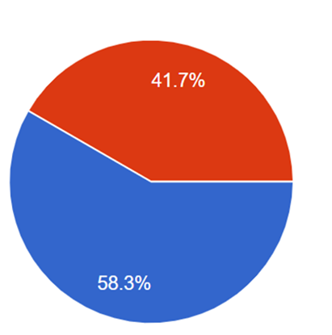
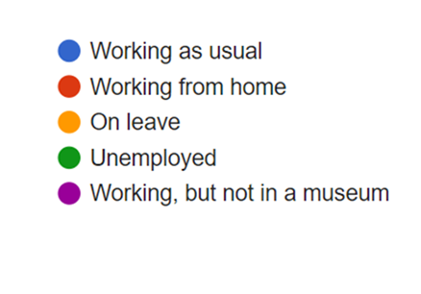

Slide 7
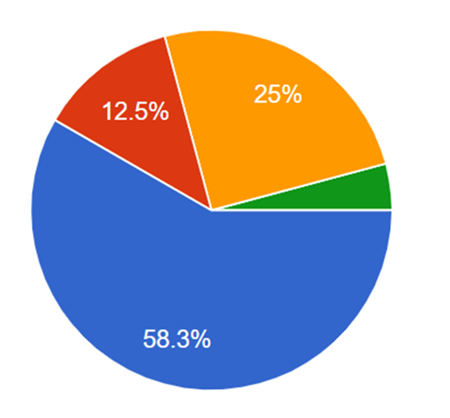
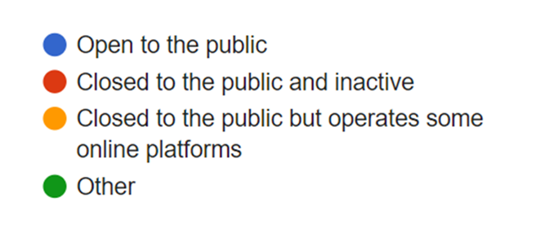

Slide 11
Recover and Reimagine

Slide 12
Please tell us about special activities your museum made during this year due to COVID-19
Enhance digital platforms and activities.
Virtual tours, online thematic events, educational activities for schools.
Shifting activities from indoor to outdoor spaces.
Reduced group size to maximum 15 people.
More research and projects than in other years.
On-line exhibitions and on-line educational programs for school children and students.
Online quizzes, more interactive contents on social media, open air workshops.
Outdoor scavenger hunt game, virtual programs.
All the activities are in live streaming by YouTube channel.
Collecting objects.
Special museum on-line show in December - Holiday time, connected with main museum exhibition, but more entertaining (special guest - local musician).
We made a plan for Facebook and Instagram, like Wednesday - day for air, Friday Hello from the Museum, Sunday Brain Teasers, Quizzes with prizes from our museum store etc.
Creating a YouTube channel, organizing online conferences, remodeling the permanent exhibition.
Virtual exhibitions, online lectures and a symposium. An exhibition related to the COVID 19 pandemic.

Slide 13
Most museums have increased the use of existing digital platforms, especially on social media such as Facebook and Instagram.
Few have been able to develop new platforms such as creating online or virtual exhibitions, holding online lectures or opening a YouTube channel.
One museum did not make any changes.

Slide 14
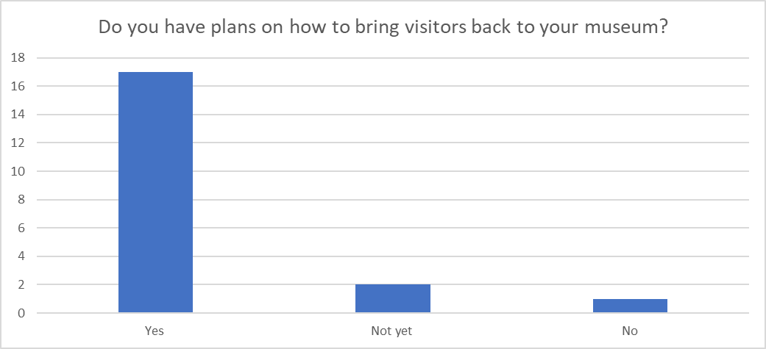

Slide 15
How to bring visitors back to your museum
New activities, some of them planned with educational and touristic agents; Outdoor activities.
A lot of promotion within the “Safe Stay“ category in Croatia; Makes the visitors feel safe; Keeping everything clean; More outdoor exhibitions.
New Programs (events, activity, visits...) and communication.
We are trying to work with the National University of Costa Rica to reactivate the space.
New exhibition.
Promotion of activities.
Updating exhibitions.
Special price rate, gifts, opening time modification.
To convince them again that the museum is a safe place.
We are developing new strategies/activities.
Reinforcing.
With interesting programs.
Always keep communicating with the public - not to lose the connection.

Slide 17
How do you think that ICR can help in this situation?
Group talk online.
Coordinating special projects that can provide extra funds to regional and local museums.
Suggestions and case studies.
Synthesis of all the museums’ answers.
Advertising and connections.
To share ideas and successful program from other museums.
With some good advice.
To help the museums creating connections between the community and cultural heritage.
To promote, at the international level, the ideas that museums are safe spaces, and that culture is an essential element of public service.
Networking, exchange of information and learn from each other's experience.
Help with technical and financial expertise.
Share Ideas of what other museums are doing to keep their audiences engaged.
Marketplace: exchange of ideas, best practice.
Sharing good practice examples.
Introducing cases from as many museums as possible to the members.

Slide 18
Please share your thoughts with us:
We should find a way to help people to be happy again. The value of museums won't drop as we are spaces of enjoyment and shared knowledge.
We must not lose focus. We can use the spare time to rethink our concepts and develop new strategies.
We need to see that European Commission arrives to all small museums, that are developing a strong social and educational task.
Cultural heritage is not only for tourists, its also for local people.
Everybody needs to feel as safe as possible
Not easy to maintain the energy and desire of the personnel and to organize the projects.
A long period of economic recovery will be needed. It means that for a long time there won’t be money for public museums. We will feel the impact of the crises in budgets.
We are building new programs to bring people back to the museum.
Joint ventures like workshops, to discuss solutions
The current situation is quite difficult because of the pandemic, but we are doing our best.

Slide 19
We became much closer during the pandemic due to the internet. Let's keep connected!

Slide 20
Thank You

